Slide 1
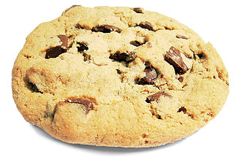
Business case
Sustainable transportation strategy for the employees of Biscuit Central

Slide 2
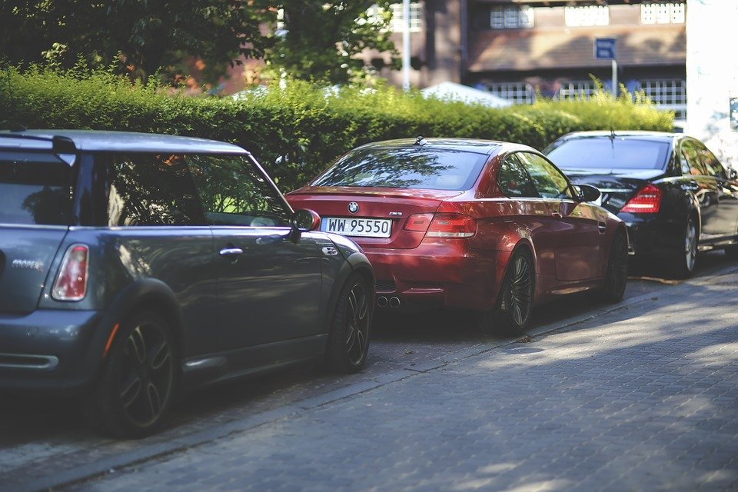
Context
Biscuit Central is a cookie factory in the city centre of X, a small city in X. We are a quickly growing company, and each month we have about 10 new colleagues. Currently, our parking lot only has place for 60 cars but the company has 120 employees… At the moment 70 of our employees come to work by car. The past year, we received complaints of the city council because our worker’s cars are blocking the streets more and more.
We urgently need to rethink our transportation strategy for employees. We want to give everyone space to park their car, but there simply is not any more room left and we want to encourage our workers to use more sustainable means of transport.

Slide 3
Limitations (or opportunities?)
In our building there are 200 square metres of unused space in the basement. Too little for parking a lot of cars, but maybe other means of transport can be stored here?
We are willing to offer incentives to the workers who use low-emission vehicles.
We are close to 2 central bike trails that are connected with a lot of cities and villages nearby.
The closest railway and bus station is 2 km away from our factory. This is a little too far to walk...
We are not very creative ourselves, but we are open to every kind of initiative and idea!

Slide 4
Good luck!

